Slide 1
Implement your own secure DevOps pipeline (DevSecOps)
Speaker name

Slide 2
Security made simple
Introduction to Zero Trust principles
Managing identities in a hybrid environment
Endpoint protection using zero trust principles
Managing the security posture of IaaS, PaaS and on prem VMs
Modern data governance with Purview
Implement your own secure DevOps pipeline (DevSecOps)
Security operations for hybrid environments

Slide 3
Agenda
Introduction to DevSecOps
What is DevSecOps?
Challenges: Difficulties in adopting DevSecOps
Solution: How to execute DevSecOps
Secure the development environment
Secure machines
Secure the pipeline
Other security measures
Demo

Slide 4
Enterprise security and development pain points
650%
Increase in supply chain attacks from 2020 - 2021
3 days
60x
69%
75%
Security cost to fix a security defect in production rather than in development
Exploitation time – Average time it takes for a hacker to exploit a vulnerability
Of third-party dependency choices made by developers are suboptimal
Open-source adoption – Average percentage of open-source code in audited code bases.
Notes:
New threats against software supply chains are more prevalent than ever with a 650% increase in software supply chain attacks from 2020-2021. Hackers have begun to realize the amount of open-source code utilized by various companies and are setting their sights earlier in the development lifecycle where crucial resources and privileges lie.
In fact, dependency on open-source code has skyrocketed within the last few years to reach 75% of audited code bases, but the amount of open source vulnerabilities has doubled from 2018 to 2020. The challenge of monitoring and maintaining the security posture of applications is becoming increasingly apparent, with recent research showing that developers make suboptimal decisions in choosing the best version of dependencies 69% of the time.
This indicates a higher level of risk for companies that don’t implement security practices and guidance in earlier phases of development.

Slide 5
Fundamentally, if somebody wants to get in, they're getting in...accept that. What we tell clients is: number one, you're in the fight, whether you thought you were or not. Number two, you almost certainly are penetrated.
Michael Hayden
Former Director of NSA and CIA
Mindset Shift: Assume Breach

Slide 6



What is DevSecOps?
DevSecOps is about integrating security into your DevOps practices and removing the siloes between development, security, and operations teams.
Shift Left
Observability
Shared
Responsibility
Notes:
You may be familiar with how DevOps practices and collaboration between developer and operations teams led to faster software delivery. DevOps combines people, processes, and technology to deliver continuous value to users.
DevSecOps is the evolution of DevOps where the company takes on a security-first mindset — putting security into every phase of the development lifecycle, from design to delivery.
When implemented successfully, companies gain both the speed of DevOps development practices and the holistic security and peace of mind that comes with DevSecOps.

Slide 7




Barriers to DevSecOps adoption
Why is DevSecOps harder to adopt than DevOps?
Organization and team gaps
Skill and knowledge gaps
Solutions aren’t built for developers
Manual work
Notes:
DevSecOps presents barriers and inefficiencies for developers that we don't find with DevOps.
These include:
Organization and team gaps: Some organizations have security-specific teams who own all of security. This siloes DevOps and SecOps teams and leads to a fragmented security culture, and over 50% of enterprises indicate this these silos as the biggest challenge to implement DevSecOps.¹
Skill and knowledge gaps: When DevOps and Developer teams don’t see security as part of their responsibly, the skill base stays solely within the SecOps team.
Third, solutions are not being built for developers, leading to issues like false positives .
False positives are high because the tools live with security teams rather than developers. Since security teams are more likely to scan repositories than developers, they may only run them once a quarter, causing them to be higher than the rate would be if these tools lived with developers.
Another issue is that we also see misaligned expectations. In DevOps, having a 30% failure rate on Unit Tests is considered very bad. However, in security, having a 30% failure rate is actually good. While you are always dealing with a trade-off between false positives and false negatives, security prefers no false negatives and more false positives. However, a developer doesn't want any false positives and doesn't care as much about false negatives.
Sources:
[1] Rethinking the Sec in DevSecOps: Security as Code A SANS Survey

Slide 8
Secure the development Environment

Slide 9
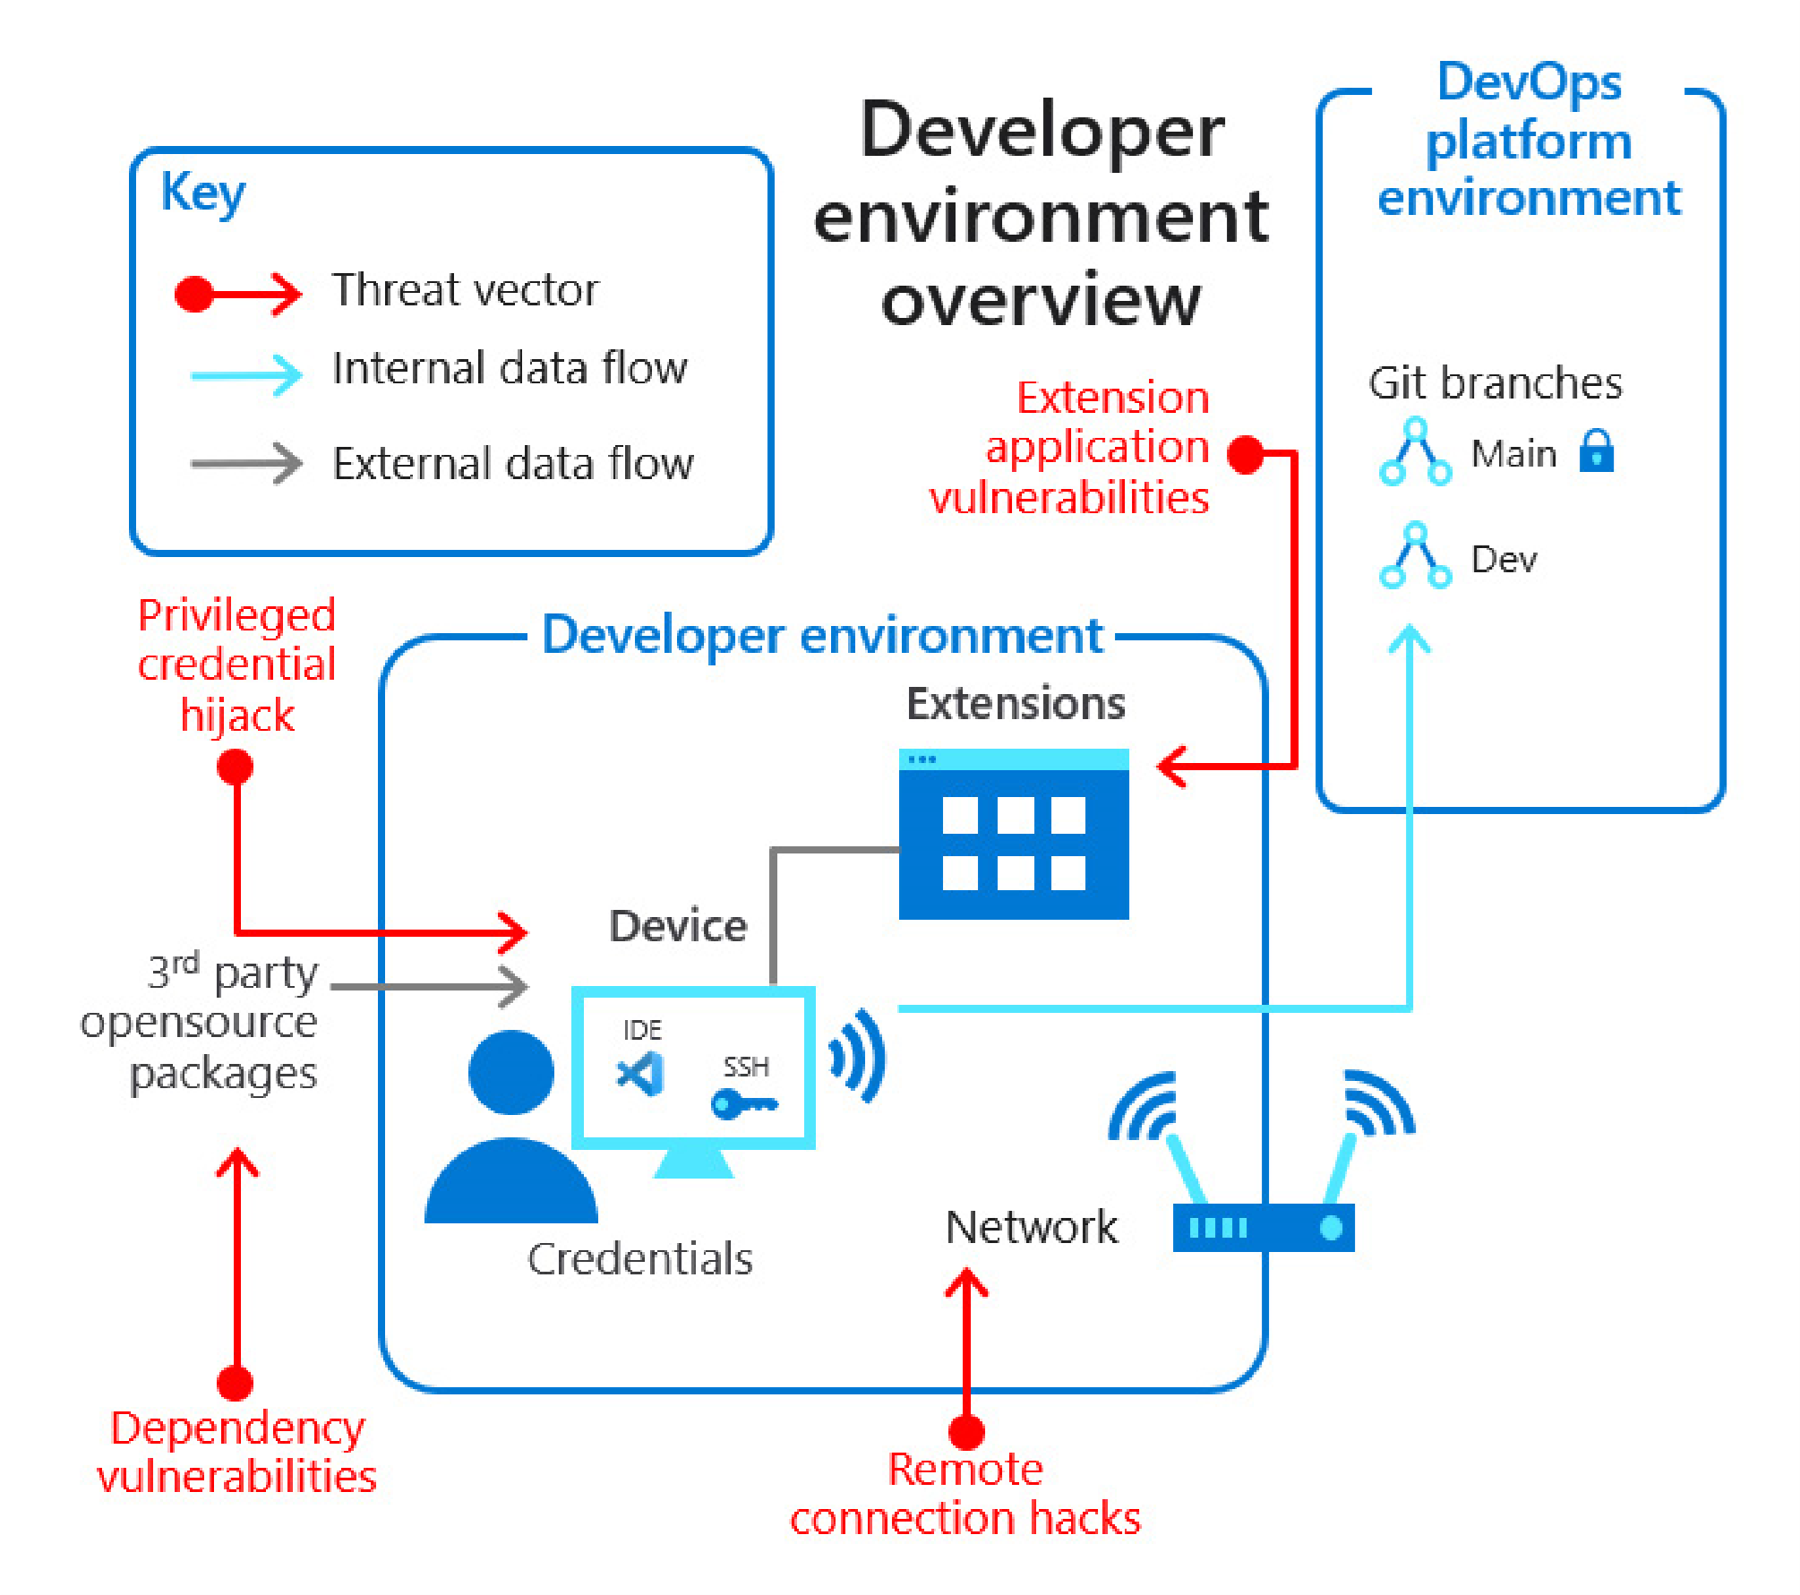
1. Secure the developer environment
Control the developer environment with a cloud environment
Secure environments with containers
Configure least privilege access policies
Limit who can change and approve code with branch security
Adopt only trusted tools, extensions, and integrations
Notes:
When it comes to server protection here are couple of our recommendations:
We would really want you to reduce the use of open network ports. There are 2 main capabilities you can use today:
First one is Just in Time Access: Brute force attacks commonly target management ports as a means to gain access to a VM. If successful, an attacker can take control over the VM and establish a foothold into your environment. One way to reduce exposure to a brute force attack is to limit the amount of time that a port is open. Management ports don't need to be open at all times. They only need to be open while you're connected to the VM, for example to perform management or maintenance tasks. When just-in-time is enabled, Security Center uses network security group (NSG) and Azure Firewall rules, which restrict access to management ports so they cannot be targeted by attackers.
Second one is to limit open ports with adaptive network hardening. Applying network security groups (NSG) to filter traffic to and from resources, improves your network security posture. However, there can still be some cases in which the actual traffic flowing through the NSG is a subset of the NSG rules defined. In these cases, further improving the security posture can be achieved by hardening the NSG rules, based on the actual traffic patterns. Adaptive Network Hardening provides recommendations to further harden the NSG rules. It uses a machine learning algorithm that factors in actual traffic, known trusted configuration, threat intelligence, and other indicators of compromise, and then provides recommendations to allow traffic only from specific IP/port tuples.
2. Second recommendation is to block malware with adaptive application controls. Adaptive application control is an intelligent, automated, end-to-end solution from Defender for Cloud which helps you control which applications can run on your Azure and non-Azure machines (Windows and Linux). Among other benefits, this helps harden your machines against malware. Security Center uses machine learning to analyze the applications running on your machines and creates an allow list from this intelligence. This capability greatly simplifies the process of configuring and maintaining application allow list policies.
3. The third recommendation is to protect Windows Servers with built in Microsoft Defender ATP. Defender for Cloud comes with best EDR in the market: Microsoft Defender ATP.

Slide 10

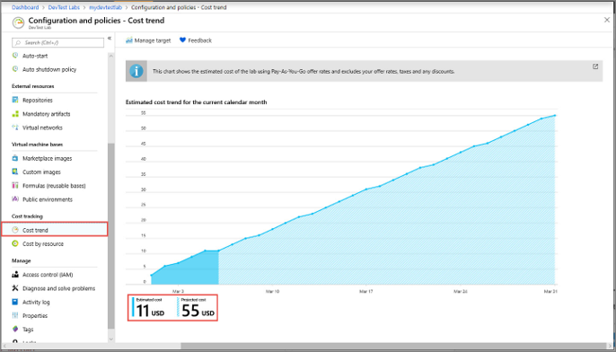
Control the developer environment with a cloud environment
Challenges
Knowledge gaps in how to start, stop and delete resources in the cloud.
Cost control
Solutions
Manage and monitor development environments through a cloud management platform.
Visualize and project resource usage aligned with cost estimation.

Slide 11
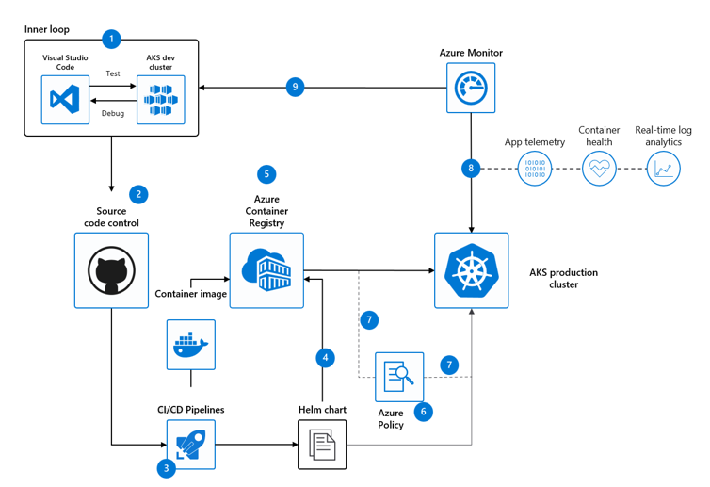

Secure environments with containers
Security advantages of containers
Segmented scope of environments and projects
Security boundaries and validations using container registry
Contained damage and automatic updates
Performance advantages of containers
Fast, easy deployment of reproducible environments
Power of local and cloud compute resources
Notes:
Minimizing risk to workload and data security is critical and to protect your containers from compromise. You can implement some of the following practices.
Limit the access to actions that containers can perform and avoid the use of root access or privileged escalation where possible
Utilize trusted, scanned images with signatures to ensure deployments are coming from a trusted location.
Assign the lowest possible permission levels for access to the Kubernetes API server
Automate security updates for container images by referencing a base image to update downstream images
Changes to identity controls like this help secure your organization against attacks like:
Malicious code injection to applications
Source code and other information exfiltration

Slide 12
Configure least privilege access to resources
Software developers are the role most targeted by hackers.
Give minimal access to resources for the shortest amount of time.
Reduce risk of exposure with identity federation
Apply strict policies on which developer device can clone systems code.
Notes:
In order to harden DevOps infrastructure, we also need to allow appropriate access to codebases.
A general rule of thumb is that everything should have a maintainer.
Least privileged access still works. When it comes to InnerSourcing, read access and contributions are always ok. Contributions must be approved by the explicit owners.
Limit elevated privileges. Do so only when absolutely necessary and implement a finite duration on higher access levels.
Changes to identity controls like this help secure your organization against attacks like:
Source code exfiltration on developer machines
Source code tampering or injection of malicious code

Slide 13

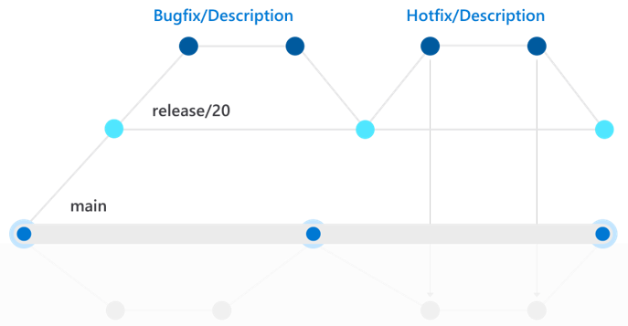
Limit who can change and approve code with branch security
Implement a branching strategy that exercises control over code
Establish clear chain of command and blueprint for addressing code changes
Instill branch protection with approval workflow of policies and reviewer requirements

Slide 14


Adopt only trusted tools, extensions and integrations
Most IDE extensions require privileges like read permissions to analyze code or connections to cloud environments

Slide 15
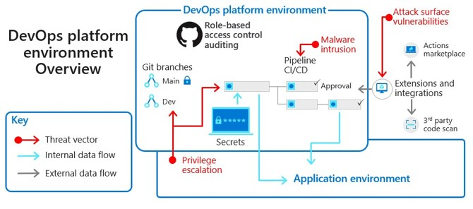
2. Secure the Enterprise DevOps platform environment
Ensure no team member has access to secrets and certificates
Automate scans for Infrastructure-as-Code (IaC) templates
Equip every DevOps platform environment with audit trails
Automate approval workflows
Secure the software supply chain
Allow only verified DevOps tool integrations

Slide 16
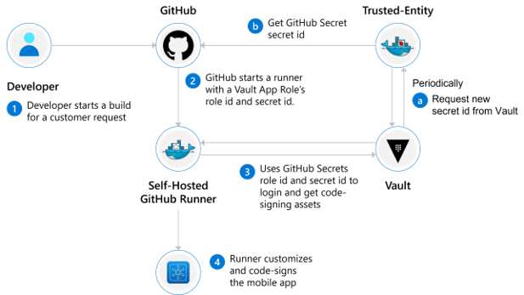
Ensure no team member has access to secrets and certificates
Don’t allow secrets to be stored anywhere in the code or on team environments
Leverage a key vault with access control for storing secrets and certifications
If possible, monitor and audit key usage with logging and send to SIEM

Slide 17
Automate Infrastructure as Code (IaC) scanning
Access control scanning to prevent compromise of misconfigured VMs
Static code analysis to validate IaC templates before provisioning
Compliance checks against relevant frameworks

Slide 18
Equip every DevOps platform environment with audit trails
Use audit trails to track:
Configuration changes to DevOps tools
Edits or additions to access security
Changes to secrets
Release pipeline activity
Notes:
Log details about each action
• The organization an action was performed
• The user who performed the action
• Which repository an action was performed
• The action that was performed
• Which country the action took place
• The date and time the action occurred

Slide 19
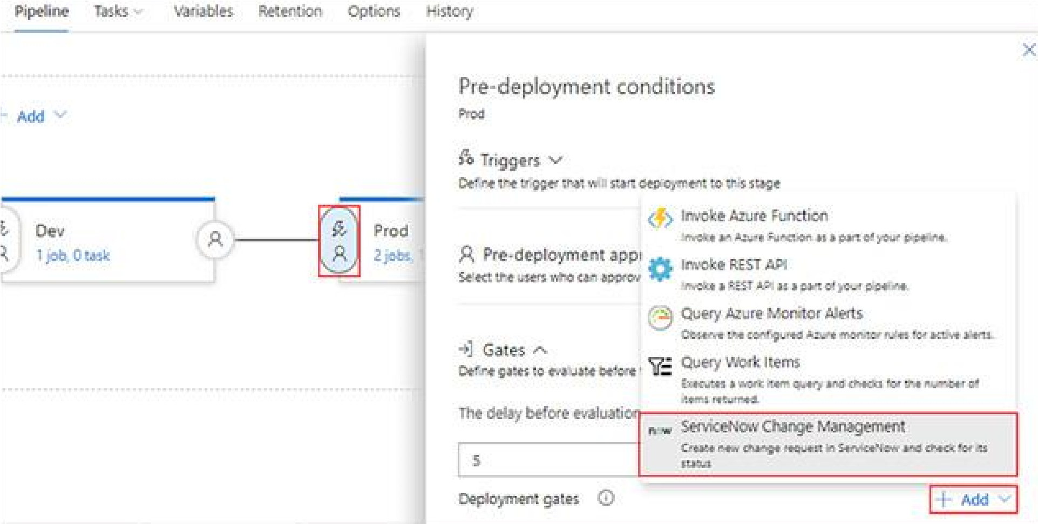
Automate approval workflows
Apply approval checks on ADO environments instead of individual pipelines
Limit approvers to reviewers within a particular ADO group
Set time out for approvals process to ensure completion in a determined period
Only allow infrastructure and app deployment from the main branch
Set constraints to prevent the pipeline executor from approving their own run

Slide 20
Secure the software supply chain
Reduce the attack surface by removing any unnecessary dependencies
Establish automated alerts to track and update dependencies
Use package managers to reduce complexity of sharing packages/artifacts

Slide 21
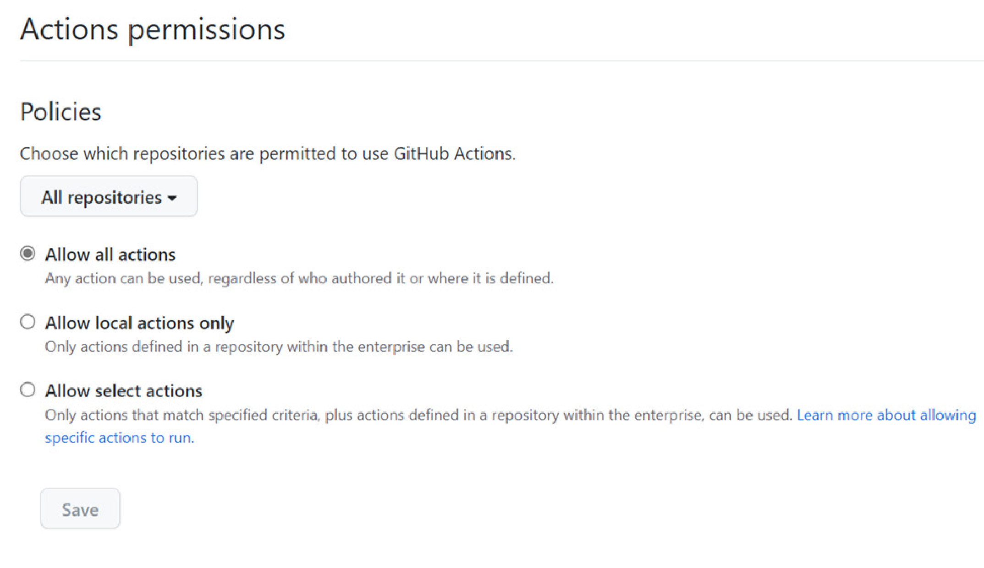
Allow only verified DevOps tool integrations
Only enable teams to use whitelisted and verified actions
Only enable validated integrations configured with least privilege access

Slide 22
Harden Pipeline Access
Create AAD and device polices that will secure development machines. For example, if a device gets lost, wipe the device.
Ensure all operations adhere to least-privileged principles. A privileged operation means granting more privileged access, adding a user, changing build / deployment steps, etc.
Run regular Identity Access Management scans that enforce least privileged access policies
Use multi-factor authentication and dual key/JIT approval for privileged operations and human-induced pushes, like CI/CD. Dual key addresses credential loss and malicious insiders, which is critical to use.
Enable endpoint protection
And lastly, inject identity early in the automation pipeline: Injecting identity as early as possible into automation pipelines is a key step to minimizing the exposure of sensitive accounts and credentials.
Notes:
Enable endpoint protection: Imagine if a developer’s laptop was affected by ransomware… To protect these endpoints, deploy an endpoint protection platform, including next-generation antivirus (NGAV) to protect against unknown and zero-day malware, behavioral analysis to identify anomalous activity on an endpoint, and vulnerability scanning.
And lastly, inject identity early in the automation pipeline: Injecting identity as early as possible into automation pipelines is a key step to minimizing the exposure of sensitive accounts and credentials. This way, your DevOps team can remove static credentials from code, replacing them with just-in-time credentials that help to reduce the threat surface and enterprise-wide risk.
Fortifying identity controls like this helps protect against attacks like:
Compromised credentials (2018 eslint incident is a good example of this type of attack)
Malicious insiders

Slide 23
Demo
Configure the MyHealthClinic project on Azure DevOps.
Integrate software composition analysis on Azure DevOps Pipeline
Configure the Microsoft Security DevOps Azure DevOps extension.
Configuring pipeline security and settings

